Slide 1
MARIGOT SUNSHINE LIMITED
This PowerPoint Presentation and associated Video File and commentary is copyrighted to:
Marigot Sunshine Limted
Kayansyel
P.O. Box MG7196
Marigot Bay
Castries
Saint Lucia.
Notes:
Welcome to this presentation of a proposal for a Marina for Vieux Fort.
Many thanks for giving me the opportunity to make this presentation. May I stress that this proposal remains confidential until publication is permitted by the author.

Slide 2
A MARINA FOR VIEUX FORT
A Proposal for a Yacht Marina, Hotel, Restaurants & Retail Outlets for Vieux Fort Bay with Potential Expansion to Conference / Exhibition Space
Notes:
The southern town of Vieux Fort is the second largest in Saint Lucia but has never really enjoyed the growth enabled by the development of the tourism and yachting industry elsewhere on Saint Lucia. This proposal seeks to redress that position by taking full advantage of the town’s location, facilities and skills in the creation of a medium sized marina focussing on the yacht charter industry, associated with a hotel and space for a conference facility.

Slide 3
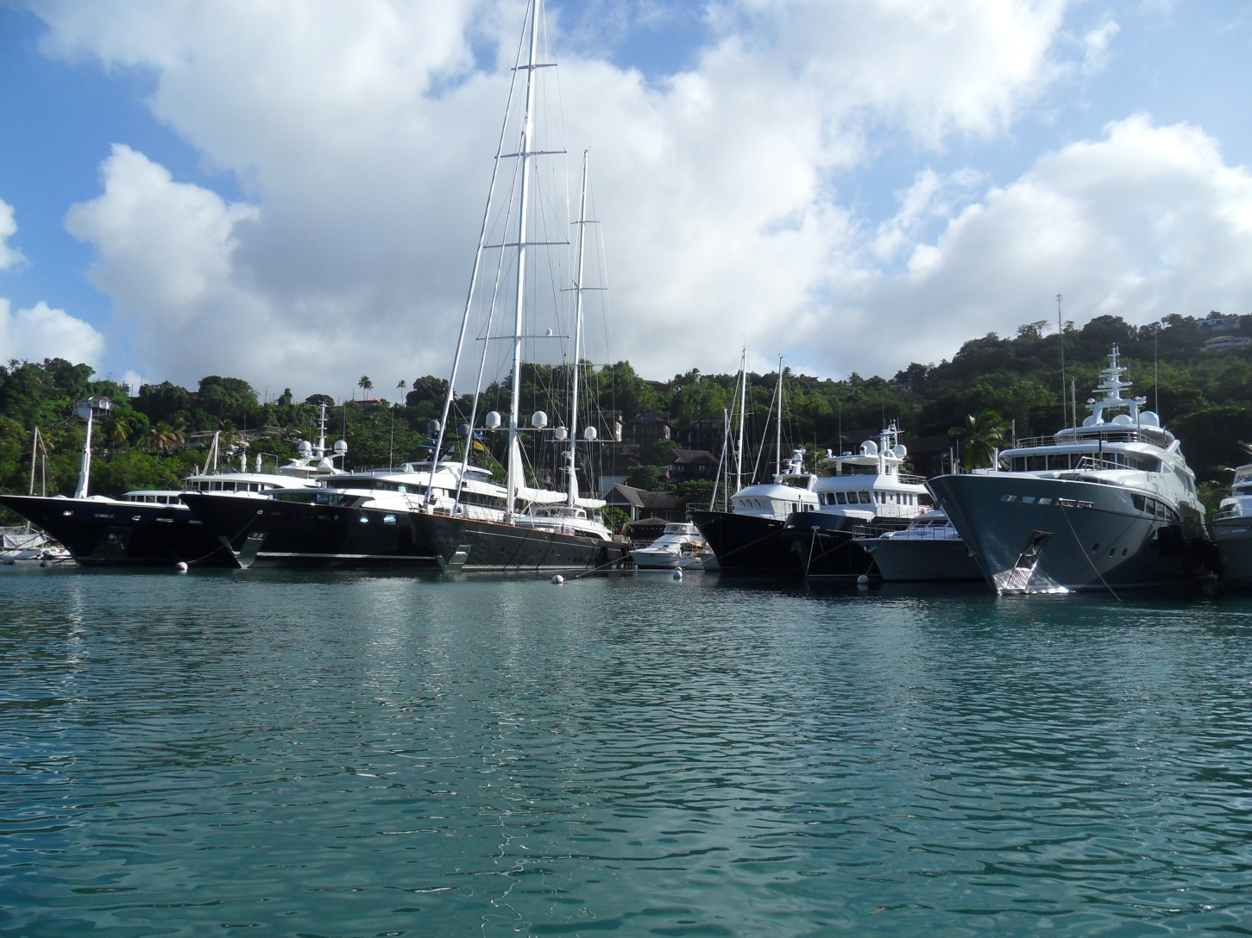
Marinas & Yachting on Saint Lucia
Notes:
There are presently two significant marinas in Saint Lucia, the IGY Rodney Bay Marina at Gros Islet in the north of the island with a total of 253 berths of which 33 are capable of berthing superyachts (yachts over 30 metres/100 ft in length) and The Capella Marina at Marigot Bay with 42 berths of which 13 are superyacht capable. There are additional private facilities at The Landings and within the Rodney Bay lagoon and Marigot Bay. Significant numbers of yachts visit Soufriere and The Pitons without using the existing marina facilities.

Slide 4
The Charter Industry
Marigot Bay…Christmas 2013
Of the yachts in that picture only 2 were not in Saint Lucia to collect Christmas Charters
The Yacht Charter Industry, large yachts and small, now dominates yachting in the Caribbean.
And the yachting destination in the Windwards Islands…
  The Grenadines
Notes:
Over the last 5 years and provoked by the Global Financial Crisis there has been a significant movement away from private yacht ownership towards yacht charter and fractional ownership schemes. There are now upwards of 3,000 charter yachts of all sizes operating in the Eastern Caribbean during the high season with their activity focussed on The British Virgin Islands, St. Martin / St Barth’s and the Grenadines. Because of the lack of an international airport serving the Grenadines, charter yachts cruising this area are picked up in Martinique, Saint Lucia and Grenada. Marinas north of the Grenadines rather than to the south are preferred by charterers because of the difficulty of the northbound trip early in the charter period.

Slide 5
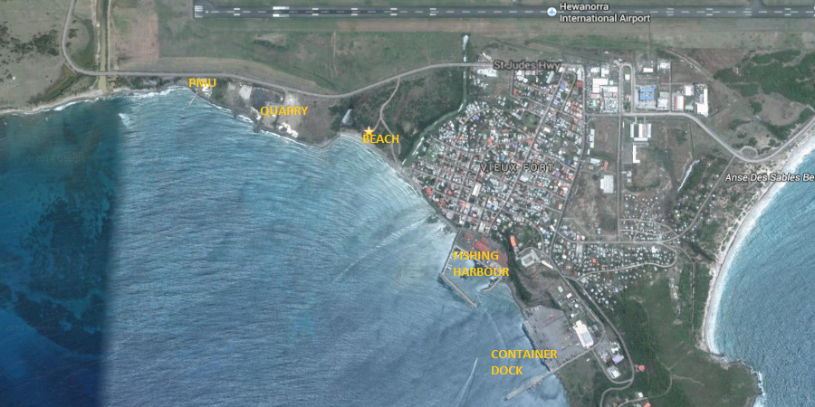
The Caribbean…Vieux Fort Bay
Notes:
Vieux Fort Bay is a naturally sheltered area, the shape of the Moule a Chique peninsular to the South of the bay protects the bay from the trade wind swells. Wave propagation studies undertaken for other projects reveal remarkably little in the way of storm swells and surge even in the case of an onshore blowing storm or hurricane, especially in the northern half of the bay. Saint Lucia has only experienced one “Intense Hurricane” Category 3 or above since 1851 when accurate records began. In general intense hurricanes develop either north of or west of the island depending on the year’s weather pattern. The marina engineering is designed to protect against a “50 year event”. That is weather conditions that can only be expected once every 50 years.

Slide 6
Vieux Fort Bay … For & Against
FOR
  Sheltered Caribbean Waters
  Existing Port Infrastructure
  Proximity to Local Industry & Shopping
  Good Use of disused land
  Consistent with local plans
AGAINST
  Intrusion on local beach
  Conflict with possible larger scale developments
Notes:
The area proposed for the marina development is to the north side of the bay in the area currently occupied by a rock shipping site operated by a quarry in Laborie some 4 miles west of the site. The land area is owned by Invest Saint Lucia. This is adjacent to the local beach. The Vieux Fort Tourism Development Group is creating a Strategic Plan for the Development of Tourism in Vieux Fort and its surroundings, this plan includes a proposed marina, hotel and conference facility. A number of larger studies have also been undertaken that could conflict with this proposal, emphasizing the need for such a strategic plan developed locally.

Slide 7
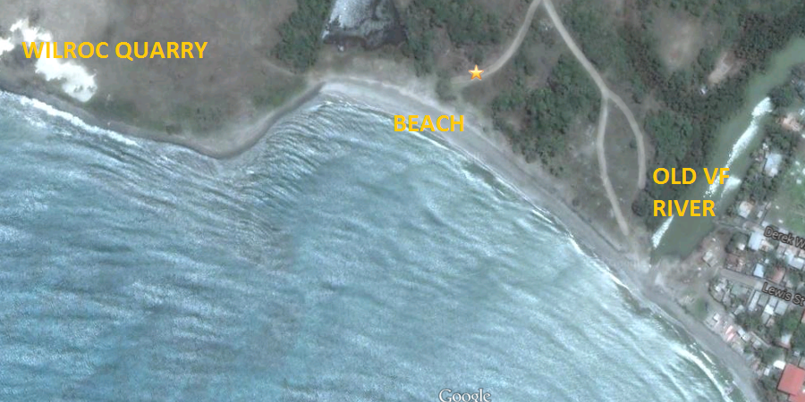
BEACH SITE – Not Preferred
Notes:
Of two possible sites in the bay the beach site is feasible but not preferred because of higher project costs in reclaiming land and dredging. There is also a clear conflict with local beach use. The land behind the beach, however, provides potential for future expansion and allied businesses.

Slide 8
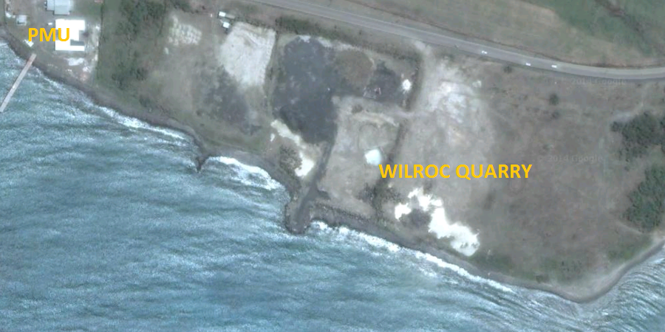
QUARRY SITE - Preferred
Notes:
Whereas the quarry site has already been reclaimed and the majority of the necessary amount of dredging has been completed. The land was reclaimed in the 1990s and dredging undertaken for the construction of a marina project that never happened remarkably but co-incidentally similar to this proposal. The only significant issue is a mutually agreed solution to the relocation of the existing tenant(s) of the land.

Slide 9
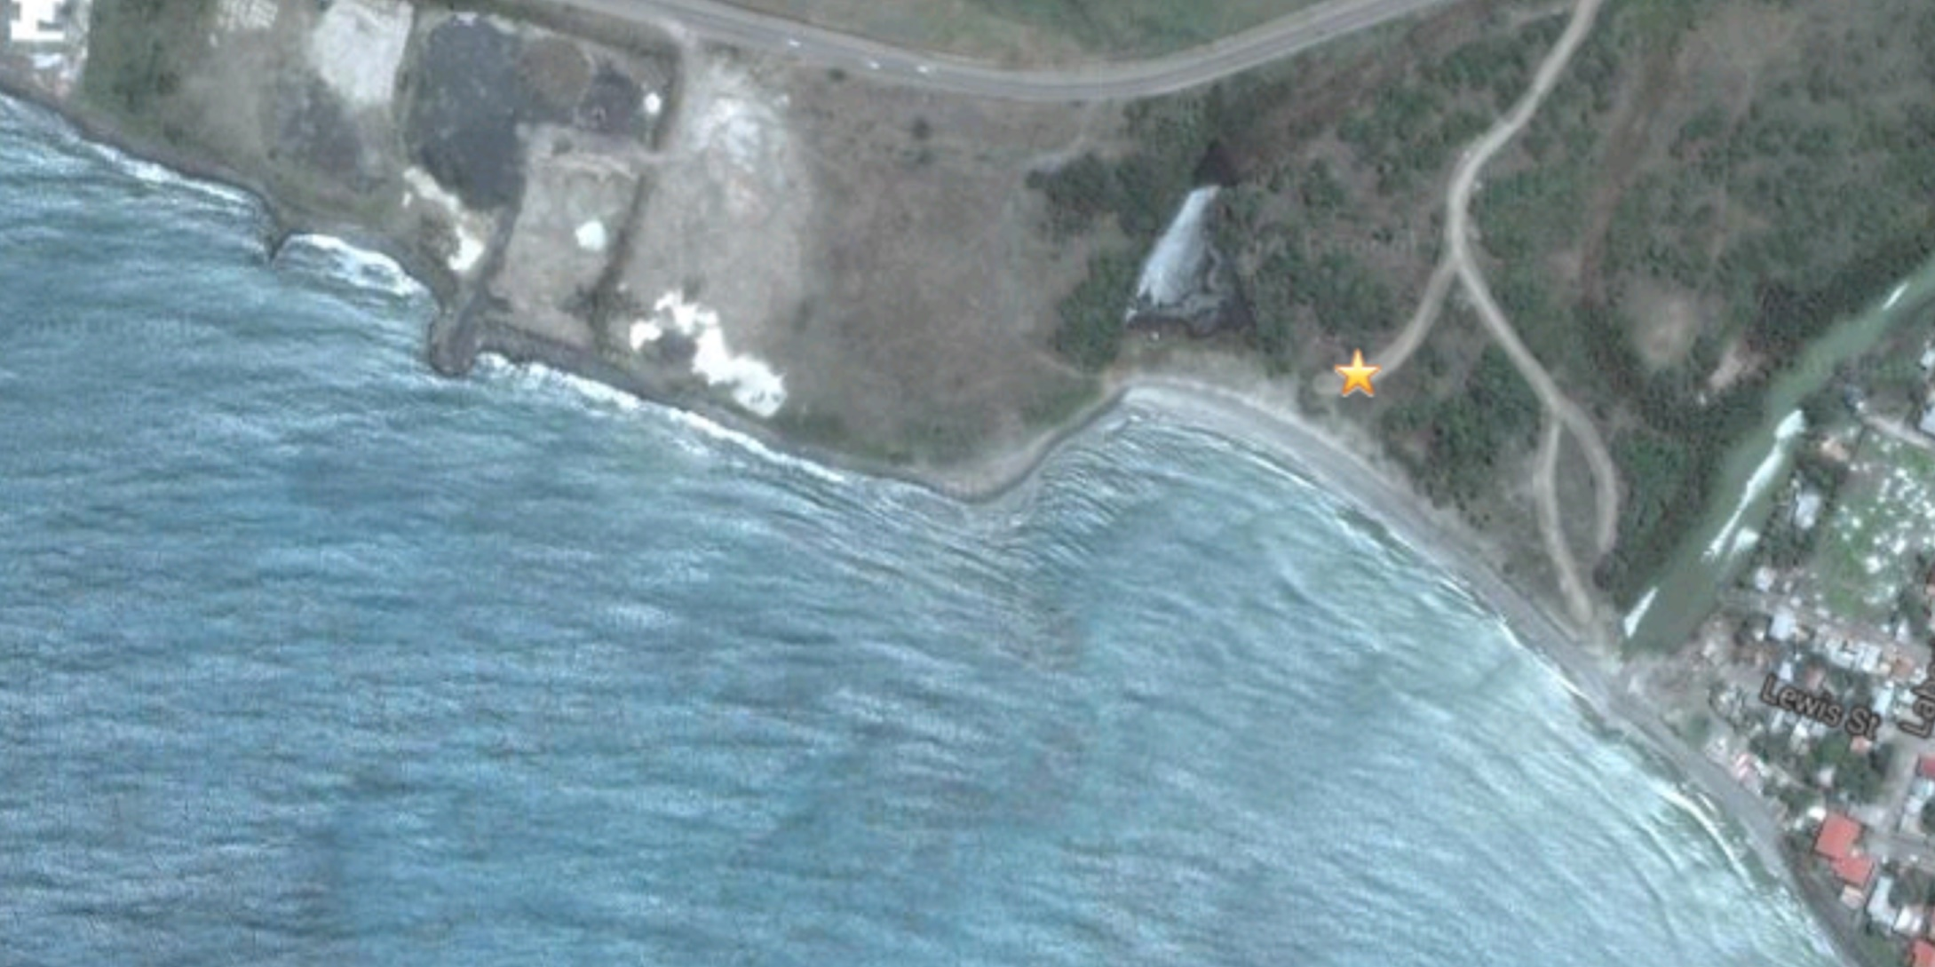
Vieux Fort Marina
Notes:
The proposed marina and hotel have been designed to integrate well into the environment.

Slide 10
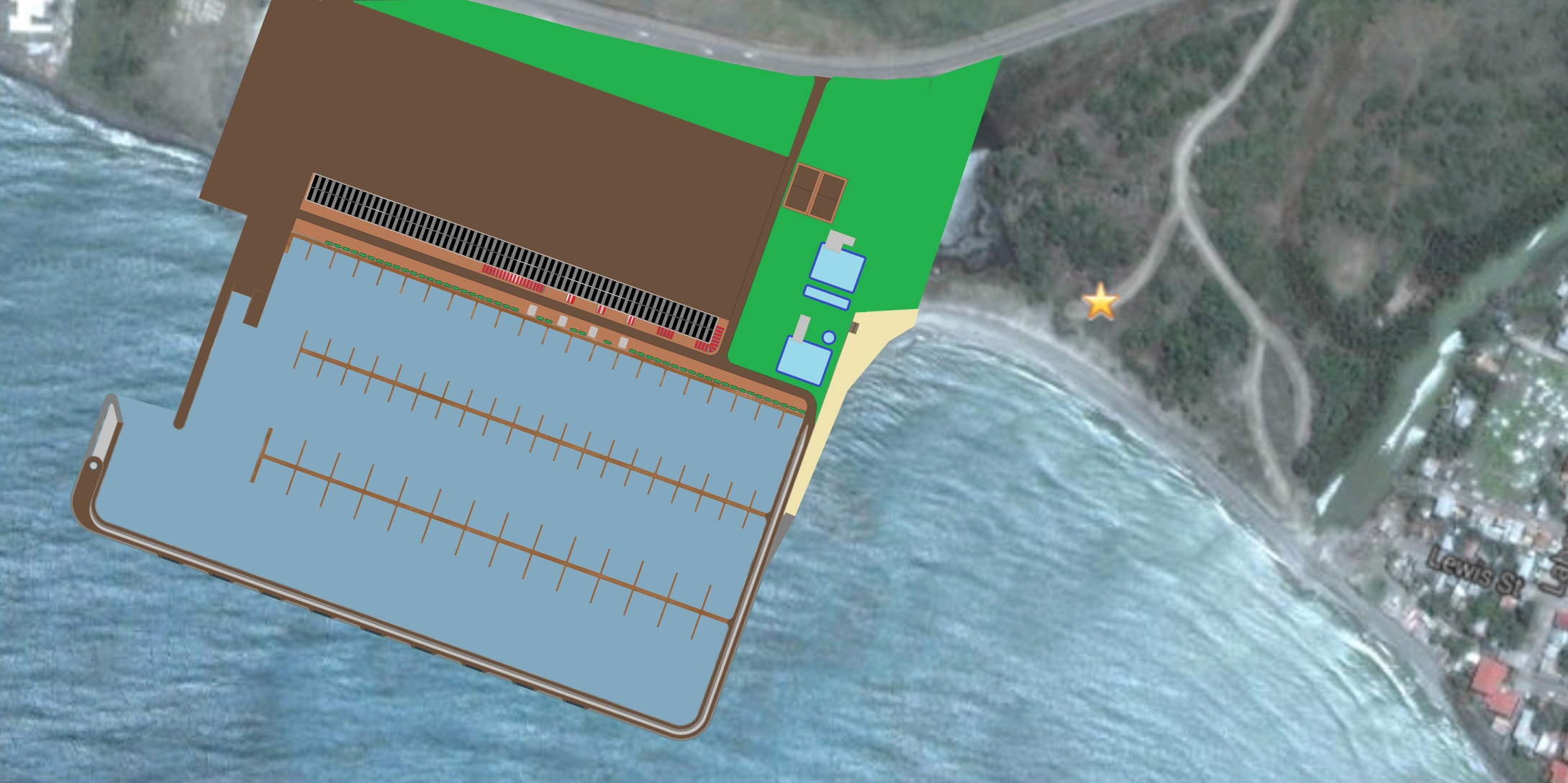
Vieux Fort Marina
Notes:
The proposed site is well serviced by the West Coast highway at a distance of 4.4 km from the airport terminal and less than 2 km from the proposed private jet terminal. The proposal is an excellent use of the unsightly reclaimed land and does not impinge significantly on the Vieux Fort beach, in many ways it enhances it.

Slide 11
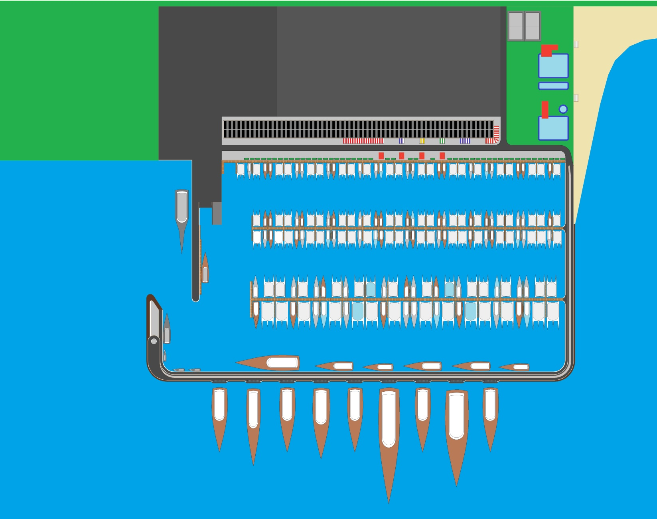
FACILITIES
200 Berths
100 Room Hotel
Swimming Pools
Restaurants
20,000 sq. ft. Retail Space
10,000 sq. ft. Technical Space
Police Marine Unit Base
Customs Office
Immigration Office
SLASPA Office
Boatyard – 150 yachts.
Ferry / Craneage Berth
300,000 sq. ft. Exhibition Park
Notes:
The marina facilities are extensive and the balance of berthing is geared to the anticipated charter market of 5 years ahead. Development of the market has shown both an increase in yacht size and an increasing domination of catamarans rather than monohull yachts, both sail & power.

Slide 12
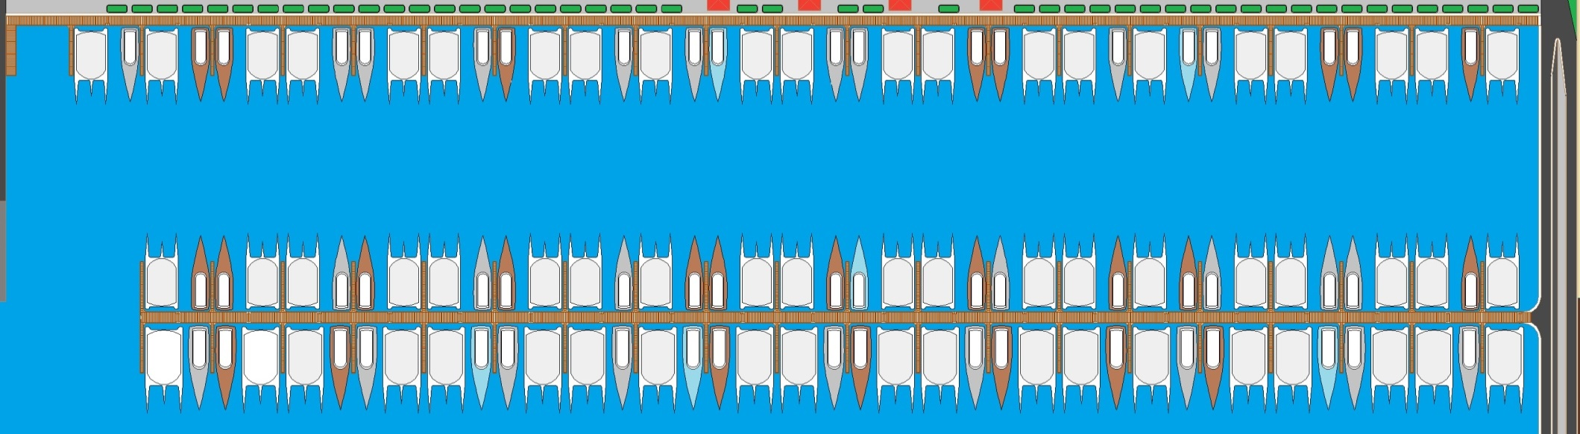
125 @ 10 – 17 Metre Berths
50 / 50 Mix of Catamaran & Monohull Berths
Potable Water, Black & Grey Water Pumpout
115 / 230 V 50 and 60 Hz Power (16, 30, 32 & 50 Amp Outlets)
Vehicle access to head of dock.
Notes:
The marina features 125 yachts in the range 10 – 17 metres length overall, that is 33 – 58 feet. Each berth is serviced with drinking water supplied from the facility’s rainwater harvesting and water purification system, and each berth is serviced with a waste pumpout system designed to cope with black water (sewage), grey water (washing waste) and also bilge water with limited oil content.

Slide 13
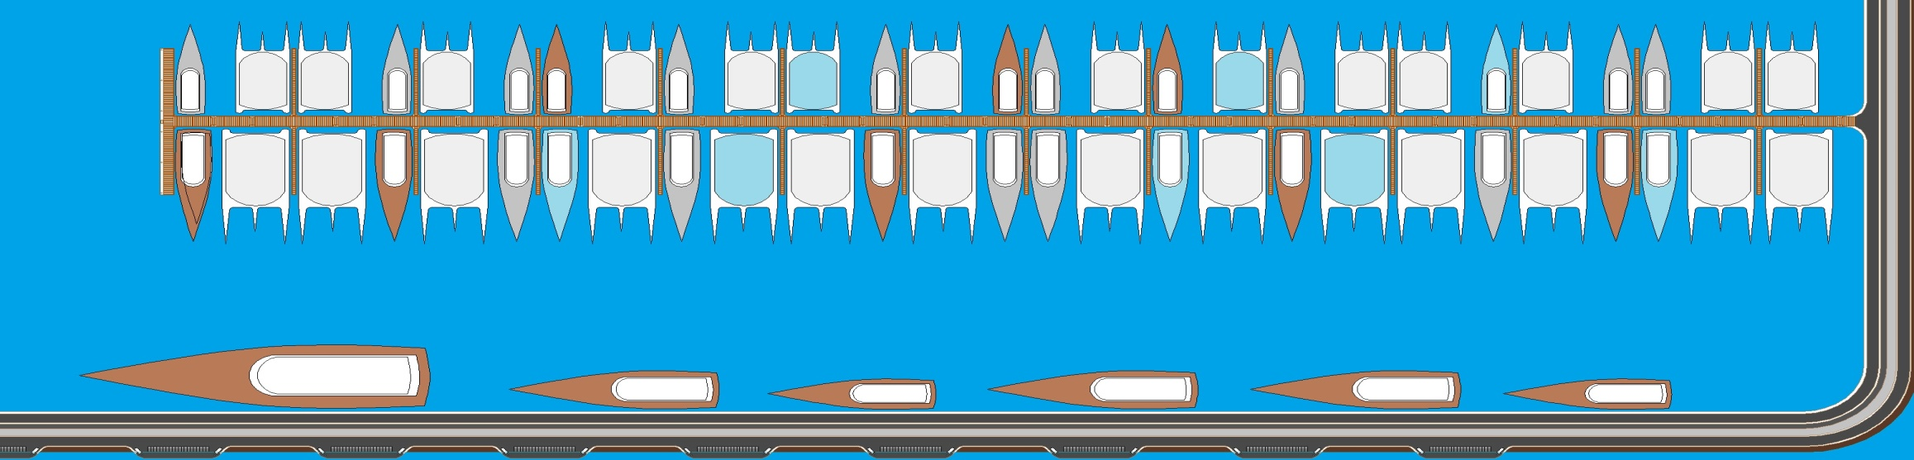
60 @ 18 – 40 Metre Berths
40 / 60 Mix of Catamaran & Monohull Berths
Potable Water, Black & Grey Water Pumpout
230 V 50 / 60 Hz Power (@32, 50 & 100A). 208 / 410V 50 / 60 Hz 3 Phase (@ 63, 100, 125A)
Vehicle access to dock.
On Berth Fuelling (25-40 Metre berths)
Notes:
In addition to the smaller yacht berths there is provision for 60 berths in the range 18 – 40 metres, that is 60 – 130ft. Each berth is also serviced with the full range of electrical supplies to both European and US standards to avoid generator pollution. Berths for the larger yachts will have on-berth fuelling with a vacuum spill prevention system.

Slide 14

9 @ 40 – 150 Metre Berths
Minimum depth 5 metres, mooring buoys.
Potable Water, Black & Grey Water Pumpout
410V 50 Hz 3 Phase (@ 125A & 200A)
Vehicle access to berth, parking at berth.
On Berth Fuelling
Notes:
The final set of berths is a group of 9 berths for yachts 40 – 150 metres long, that is 130 – 500 feet. The very largest superyachts, known as gigayachts when over 100m (330ft) long have very limited options for berthing and are usually forced to use commercial and cruise ship berths. The excellent shelter in Vieux Fort bay allows 9 berths on the outside of the marina breakwater that will be configured with moorings to accommodate up to 150 metres length overall or possibly larger if demand justifies the installation costs. A minimum depth of 5 or 6 metres would be provided at the breakwater deepening to 8 metres at the keel position of the largest sailing gigayachts. These berths would be configured to provide full security compliant with the ISPS Code, vehicle access to the stern of the yacht and complete privacy for the VVIP guests on arrival.

Slide 15
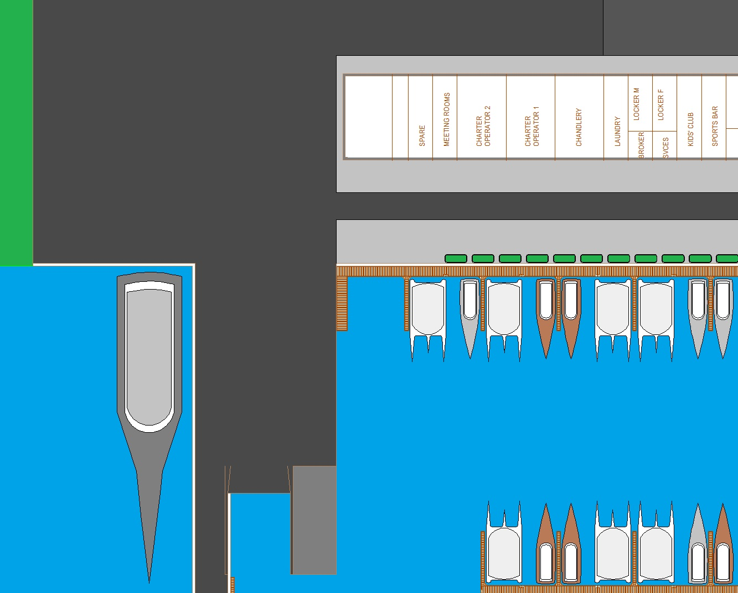
BOATYARD
Dry Storage
Travel Hoist 30m x 12m
Slipway
Craning Dock
Ferry Dock
Fuel Dock
Chandlery
Workshops
Laundry
Charter Offices
Yacht Services
Yacht Broker
Crew / Sports Bar
Notes:
In order to service an anticipated fleet of 120 bareboat charter yachts and 30 or 40 transient skippered charter yachts a boatyard and engineering facility is incorporated to include a boat lift, slipway, craning dock and shore side workshops and stores. Facilities for professional yacht crew, with a strong emphasis on sports and recreation are also important and the proximity of the kitesurfing Mecca of Anse des Sables is a significant asset.

Slide 16
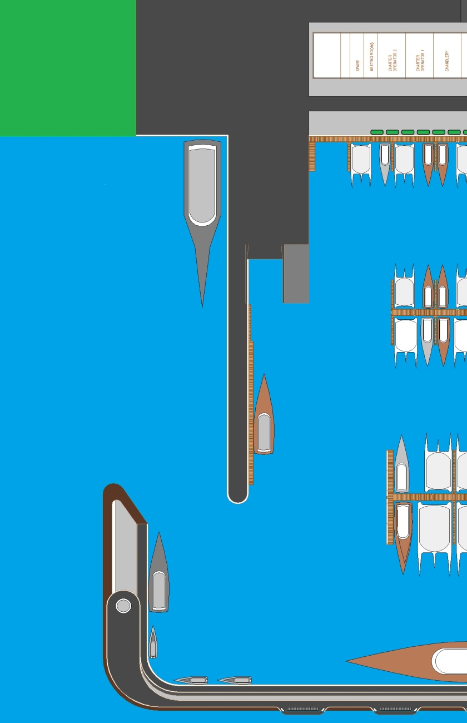
GOVERNMENT FACILITIES
Marine Police & Coastguard Base
Observation Tower
Customs Office
Immigration Office
Ports Office
Total Office Area 3,000 sq.ft. over 2 floors
Bonded Store
Freeport
Ferry & Yacht Reception Area
Notes:
In order to function as an effective yachting Port of Entry it is essential that there are Customs, Immigration and Ports offices on site. This has been sized to allow for development of small international ferry services from the marina. Additionally the opportunity presents itself to provide the Police Marine Unit with satisfactory berthing and shoreside facilities with an observation tower on the outer breakwater for Coastguard and Search and Rescue use.
The effectiveness of the Marina in competition with the Leeward Islands superyacht base of St. Martin would be significantly enhanced by the creation of a Freeport where goods in transit do not require Customs Clearance for the transfer from Air or Sea Port to Yacht.

Slide 17

100 Room 3 / 4 Star Hotel
Restaurants: Local, International, Ethnic.
Pools, Beach & Beach Bar
Licensed Local Vendor Arcade
Solar Water Heating & Air Conditioning
Rainwater Harvesting & Water Treatment
Sewage Treatment Plant & Irrigation.
Notes:
A hotel of around 100 rooms is proposed, targeting 4 specific markets: Marina guests, distressed flight guests, visitors and conference / exhibition guests. A simple 3 storey concrete structure is proposed with the ground floor dedicated to retail shopping, restaurants marina technical facilities and hotel reception & offices. The space allocated to the hotel over the upper 2 floors allows 94 rooms each with an area of 600 sq. ft. including a covered terrace of 100 sq.ft. The central lobby on each floor will allow elevator access, offices, housekeeping and engineering services for each level.
A largely flat roofed design enclosed by a parapet wall is envisaged to allow the efficient installation of around 30,000 square feet of photovoltaic panels generating around 300KW of electricity at peak output, sufficient to power a chilled water air conditioning system using insulated cistern space under the building for overnight storage. There would also be space for around 6,000 square feet of solar water heating panels with roof mounted storage tanks. The entire building would be double glazed both for heat and sound insulation reasons and the latest energy control systems would be fitted. The hotel would feature a full rainwater harvesting system with cistern storage under the hotel.

Slide 18
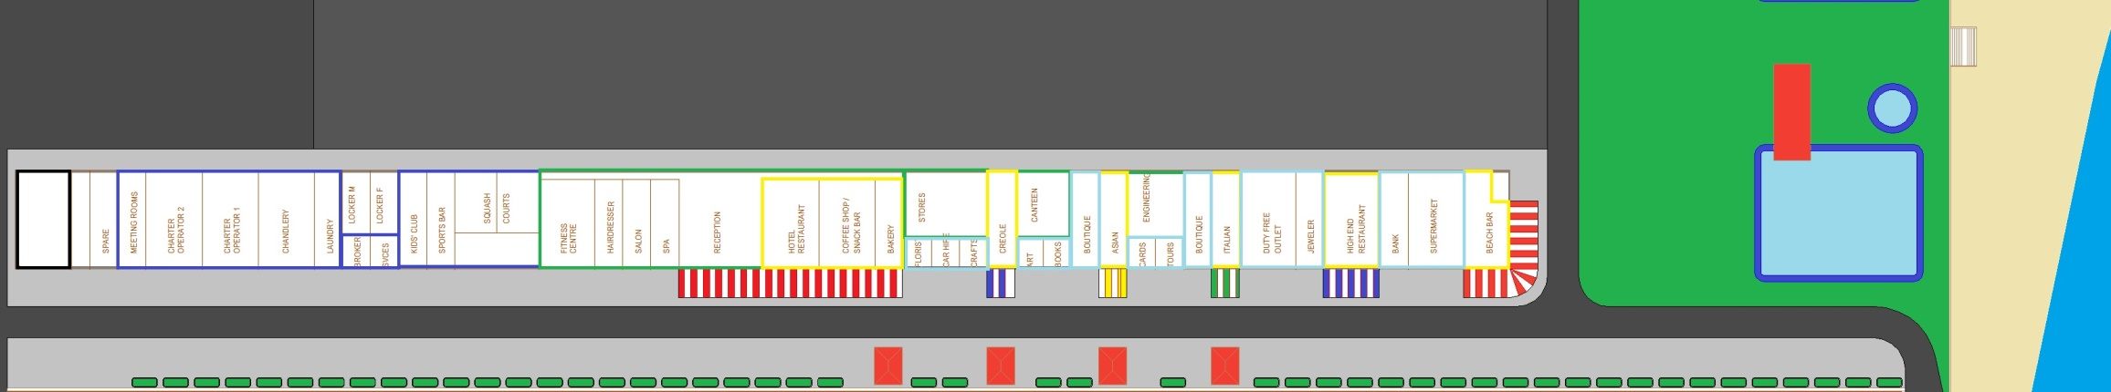
Shops, Restaurants & Offices
Government Offices 3,000 sq. ft.
Technical, Sports & Crew Facilities 10,500 sq. ft.
Hotel Reception & Offices 10,000 sq. ft.
Restaurants 11,500 sq. ft.
Retail Outlets 8,500 sq.ft
Notes:
The ground floor of the hotel building is given over to Government Offices, Marina technical facilities, sports and crew facilities, the Hotel reception, offices and back of house facilities, restaurants and retail outlets. A total of 7 different restaurant outlets is proposed ranging from a beach bar at the beach end of the building to a high-end restaurant aimed at yacht guests and VIP visitors. The hotel operated restaurants would have sufficient capacity to provide breakfasts and a limited number of all-inclusive or meal packages for guests. The majority of the restaurants would be rented, however, to local operators.
Shops include a small supermarket, bank / ATM, Jeweller, Duty Free Shop, Boutiques, a large number of small local craft outlets, florist, car hire, tours office, bookshop as well as the more technical services of a yacht chandlery, charter broker, yacht services office, etc. The emphasis again would be on encouraging local operators and tenants.
Space has been allocated within the building to allow 2 squash courts and a games room / table tennis area. Space outside allows 2 main pools, a lap pool and a children’s pool together with direct beach access and 2 tennis courts.

Slide 19
Financial Basics
Marina Docks, Breakwaters & Infrastructure Construction
  US$ 20 Million
Potential Annual Gross Revenue
  US$16,701,000
Annual Overhead Costs
  US$1,141,300
Potential Annual Net Income (Before Tax)
  US$6,410,000 Million
Occupancy for 10% ROI
  39% High Season, 34% Low Season
Notes:
The breakwaters, sea wall and docks have been designed to a level sufficient for a cost estimate from a Barbados based Marine Civil Engineering Contractor at US$20 million. In the unlikely event that all berths are full for the High Season and 75% for the Low Season with full fuel, water & electricity sales for the types of yacht berthed then the annual gross income could be nearly US$16 million and net profits of US$6 million. More realistic assessments centred around a ROI of 10%, the normal Marina CAP rate, gives a required high season occupancy under 40%.

Slide 20
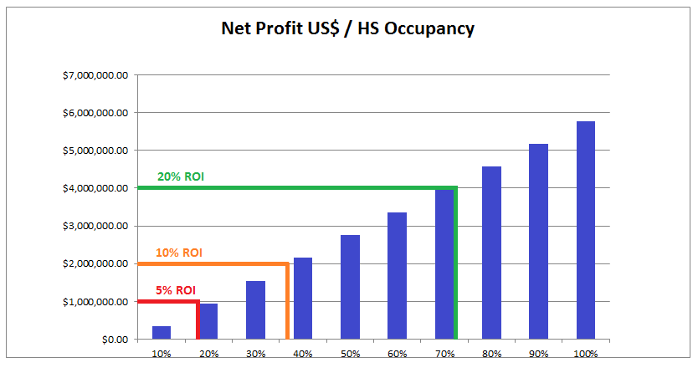
Financial Returns
Notes:
This chart simply illustrates the projected relationship between occupancy and profit. The Marina at Marigot Bay, without The Moorings Charter Company was hitting occupancies of around 70% High Season and 55% Low Season measured in the same way.

Slide 21
In Anticipation of a Positive Reply
Notes:
In conclusion, this proposal provides a nucleus for the waterfront development of Vieux Fort as a Tourism Area. Marigot Sunshine Ltd. is committed to the concept of sustainable and community centred tourism and the Marina for Vieux Fort has been tested rigorously against those principles to be inclusive of the Vieux Fort Community providing enhancement, employment and accessible facilities and business opportunities for that community.

Slide 22
Thank You
Notes:
THANKYOU
If you have any questions please feel free to ask. Equally I can be contacted by phone on +1 758 719-9981 or by email on bob@marigotsunshine.com.

